Slide 1
EDP Architecture

Slide 2
Snowflake High Usage Patterns
# | Use Case | Snowflake Pattern Detail
1 | IoT low-latency continuous Streaming | Kafka/Azure Event Queues buffer billions of events from IoT sources delivered directly to a SnowPipe via native connector for code-free ingestion into Snowflake tables with zero latency.
2 | Longitudinal Time-Series (CDC) | Change Data Sets generated either by source RDBMS systems, by third party tools such as Oracle Golden Gate, Striim, Matillion, or HVR. Data Sets delivered continuously to Snowflake for streaming ingestion of low-latency time series data.
3 | Batch and Micro-Batch | With Snowflake’s unique micro-partition architecture, data can be ingested in parallel from dozens of sources to the same target table without any degradation in performance, or concurrency issues.

Slide 3
Snowflake High Usage Patterns
# | Use Case | Snowflake Pattern Detail
4 | Geospatial | Snowflake supports direct ingestion and storage of geospatial data with its GEOGRAPHY datatype, no special handling is required, either by third party ETL tools or by Snowflake SQL. Native support for all common Geospatial operations such as AREA, CONTAINS, COVERS, DISTANCE and so on are fully supported via SQL.
5 | Data Curation/Enrichment | In addition to standard support for data enrichment via SQL in Snowflake, there is also support for high-performance scale-on-demand functional programming in Scala, Java, and Python, all of which run natively on the Snowflake compute warehouses thereby eliminating network roundtrips.

Slide 4
EDP Architecture
DR suggestion:
We should add a box for digital products, also downstream dependencies?
We should also distinguish between production solutions and ‘discovery solutions’ one can only access production calibre data the other can have less trustworthy data to enable discovery
DR suggestion:
Can the data platform either build left to right or bottom to top please (bit pedantic, I know!)
I don’t know how to do this without making it messy, but can you include structured and unstructured?
Can we also show streaming data somehow (see examples in additional slides)

Slide 5
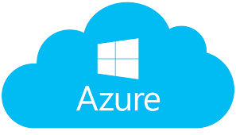

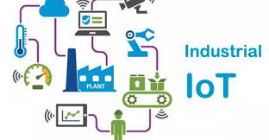



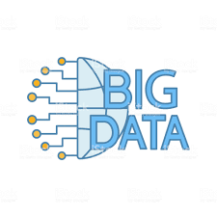

Pervasive Analytics
Technology
Enablers
EDGE & EMBEDDED
ANALYTICS
IoT
Sensors
Control Systems
STREAMING & EVENT DATA PIPELINES
Local Predictive model execution at the point of need.
Autonomous customer, value chain and industrial processes
Third Party
Public
Data
PRODUCTION
ANALYTICS
Production service level predictive model execution, machine learning operations and digital twins
BATCH DATA PIPELINES
IT SYSTEMS
DASHBOARDS
Self-service business and process intelligence
Supporting operator actions and
business decision making
DISCOVERY
ANALYTICS
Advanced visualisation, machine learning and predictive model development and training
Third Party
Public
Data

Slide 6
D&A Layered Arch

Slide 7
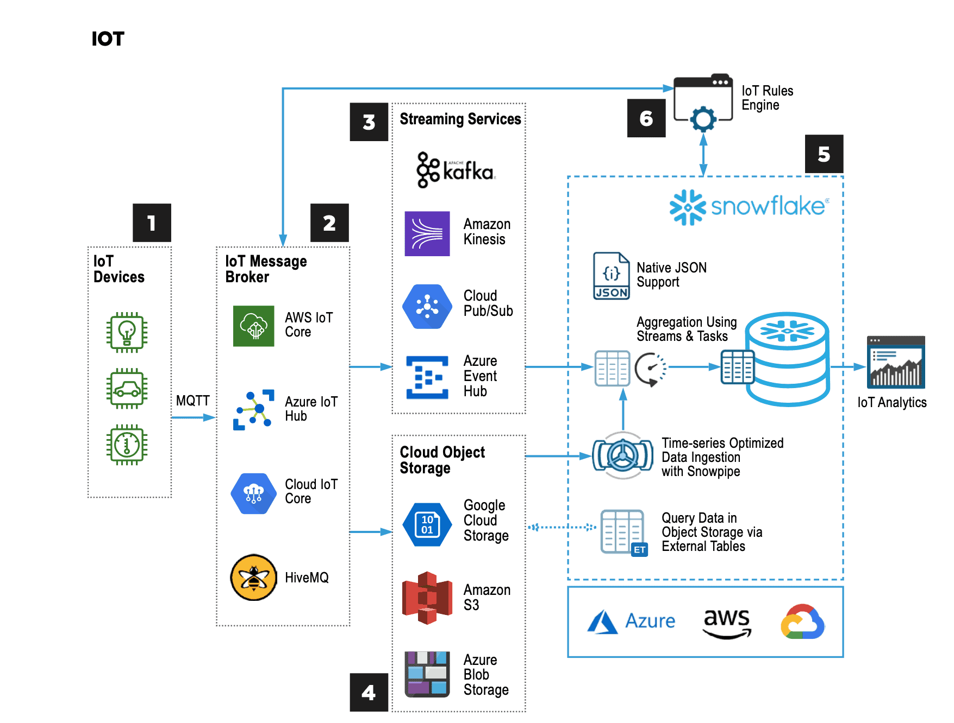
Snowflake modern reference architecture: https://www.snowflake.com/blog/modern-reference-architectures-for-application-builders/

